Slide 1
Agile Principles and Communication

Slide 2
Agile
Agile is a software development methodology that emphasizes flexibility, collaboration, and responsiveness to change. It originated in the early 2000s as an alternative to traditional, plan-driven approaches to software development. The Agile Manifesto(Document), created by a group of software developers in 2001, outlines the core values and principles of Agile development. Here's an introduction to Agile and its values:

Slide 3
Introduction to Agile
Agile is a set of values, principles, and practices that prioritize delivering value to customers, adapting to change, and fostering collaboration within development teams.
Agile methodologies advocate for iterative development, incremental delivery, and continuous improvement throughout the software development lifecycle.

Slide 4
Agile Values
The Agile Manifesto(Document) identifies four core values that guide Agile development:

Slide 5
Individuals and Interactions over Processes and Tools:
Agile values the importance of people and communication over rigid processes and tools.
It emphasizes the collaboration and interaction between team members, stakeholders, and customers to achieve project goals.
Working Software over Comprehensive Documentation:
Agile prioritizes delivering working software that meets customer needs over extensive documentation.
While documentation is important, Agile teams focus on creating executable code as the primary measure of progress and success.

Slide 6
3.Customer Collaboration over Contract Negotiation:
Agile encourages active involvement and collaboration with customers and stakeholders throughout the development process.
Rather than relying solely on formal contracts and negotiations, Agile teams work closely with customers to understand their needs, gather feedback, and adapt the product accordingly.
4.Responding to Change over Following a Plan:
Agile embraces change as a natural and inevitable part of the software development process.
Instead of rigidly following a detailed plan, Agile teams prioritize responding to change and adapting their approach based on new information, feedback, and evolving requirements.

Slide 7
Agile Principles
Agile principles are a set of guidelines that guide Agile software development teams in their approach to building software. These principles are derived from the Agile Manifesto and provide a framework for developing software iteratively, delivering value to customers, and responding to change. Here are the 12 Agile principles:

Slide 8
Customer Satisfaction through Early and Continuous Delivery of Valuable Software:
Agile teams prioritize delivering working software to customers frequently, enabling early feedback and ensuring that customer needs are met.
Welcome Changing Requirements, Even Late in Development:
Agile embraces change as a natural part of the development process and welcomes changing requirements, even late in the project, to deliver the most valuable product.

Slide 9
3.Deliver Working Software Frequently, with a Preference for Short Timescales:
Agile teams aim to deliver working software in short, frequent iterations, typically ranging from a few weeks to a few months, to ensure rapid and continuous progress.
4.Business People and Developers Must Work Together Daily throughout the Project:
Agile encourages close collaboration between business stakeholders and development teams, ensuring that both parties are aligned on project goals, priorities, and requirements.

Slide 10
5.Build Projects around Motivated Individuals, Give Them the Environment and Support They Need, and Trust Them to Get the Job Done:
Agile teams empower and trust motivated individuals, providing them with the support, resources, and autonomy they need to deliver high-quality results.
6.The Most Efficient and Effective Method of Conveying Information to and within a Development Team is Face-to-Face Conversation:
Agile values face-to-face communication as the most effective way to convey information, resolve issues, and foster collaboration within development teams.

Slide 11
7.Working Software is the Primary Measure of Progress:
Agile emphasizes delivering working software as the primary measure of progress, focusing on tangible outcomes rather than intermediate deliverables or documentation.
8.Agile Processes Promote Sustainable Development:
Agile promotes a sustainable pace of work, ensuring that development teams can maintain a consistent and manageable workload over the long term.

Slide 12
9.Continuous Attention to Technical Excellence and Good Design Enhances Agility:
Agile teams prioritize technical excellence and good design practices to ensure the maintainability, scalability, and adaptability of the software.
10.Simplicity--the Art of Maximizing the Amount of Work Not Done--is Essential:
Agile advocates for simplicity in both the software design and development process, focusing on delivering the minimum viable product (MVP) and avoiding unnecessary complexity.

Slide 13
11.The Best Architectures, Requirements, and Designs Emerge from Self-Organizing Teams:
Agile teams are self-organizing and cross-functional, allowing them to collaborate effectively, make decisions autonomously, and adapt to changing requirements.
12.At Regular Intervals, the Team Reflects on How to Become More Effective, then Tunes and Adjusts Its Behavior Accordingly:
Agile teams regularly reflect on their processes, practices, and interactions to identify areas for improvement and make adjustments to optimize their effectiveness.

Slide 14
These Agile principles provide guidance for Agile teams to deliver value, embrace change, collaborate effectively, and continuously improve their processes and outcomes.

Slide 16
Scrum Framework
The Scrum framework is an Agile methodology for managing software development projects and other complex work. It provides a structured approach to product development, emphasizing flexibility, collaboration, and iterative delivery.
Scrum is based on the principles outlined in the Agile Manifesto and is characterized by its use of specific roles, ceremonies, and artifacts. Here's an overview of the Scrum framework:

Slide 17
Roles
Product Owner:
The Product Owner represents the interests of stakeholders and is responsible for defining and prioritizing the product backlog.
They collaborate with stakeholders to gather requirements, define user stories, and ensure that the product backlog reflects the needs of the business and users.
Scrum Master:
The Scrum Master serves as a facilitator and coach for the Scrum team, ensuring that the Scrum framework is understood and followed.
They remove impediments(obstruction in doing something), facilitate meetings, and foster(encourage) a culture of continuous improvement within the team.
Development Team:
The Development Team is a self-organizing, cross-functional group responsible for delivering the product increment.
Team members collaborate to design, develop, test, and deliver working increments of functionality in each sprint.

Slide 18
Ceremonies/Events
Sprint Planning:
At the beginning of each sprint, the Scrum team holds a sprint planning meeting to define the sprint goal and select user stories from the product backlog.
The team collaborates to estimate the effort required for each selected user story and create a sprint backlog(plan by and for the Developers)containing the tasks necessary to complete them.
Daily Standup (Daily Scrum):
The Daily Standup is a brief, daily meeting where team members synchronize their work, discuss progress, and identify any impediments.
Each team member answers three questions: What did I accomplish yesterday? What will I do today? Are there any obstacles in my way?

Slide 19
3.Sprint Review:
At the end of each sprint, the Scrum team holds a sprint review meeting to demonstrate the completed work to stakeholders and gather feedback.
The Product Owner reviews the sprint goals and product backlog, and stakeholders provide input on the delivered increment.
4.Sprint Retrospective:
The Sprint Retrospective is a meeting held at the end of each sprint where the Scrum team reflects on their processes and identifies opportunities for improvement.
Team members discuss what went well, what could be improved, and create actionable items to implement in future sprints.

Slide 20
Artifacts
Product Backlog:
The Product Backlog is a prioritized list of all desired features, enhancements, and fixes for the product.
It is maintained by the Product Owner and serves as the single source of truth for the Scrum team's work.
Sprint Backlog:
The Sprint Backlog is a subset of the product backlog containing the user stories and tasks selected for the current sprint.
It is created during sprint planning and serves as the plan for the work to be done during the sprint.

Slide 21
3.Increment:
The Increment is the sum of all the completed user stories and tasks delivered by the Scrum team at the end of each sprint.
It is a potentially shippable product increment that adds value to the product and can be released to stakeholders.

Slide 22
Conclusion
The Scrum framework provides a flexible and adaptable approach to software development, allowing teams to deliver high-quality products iteratively and incrementally.
It emphasizes collaboration, transparency, and continuous improvement, enabling teams to respond quickly to changing requirements and deliver maximum value to stakeholders.

Slide 23
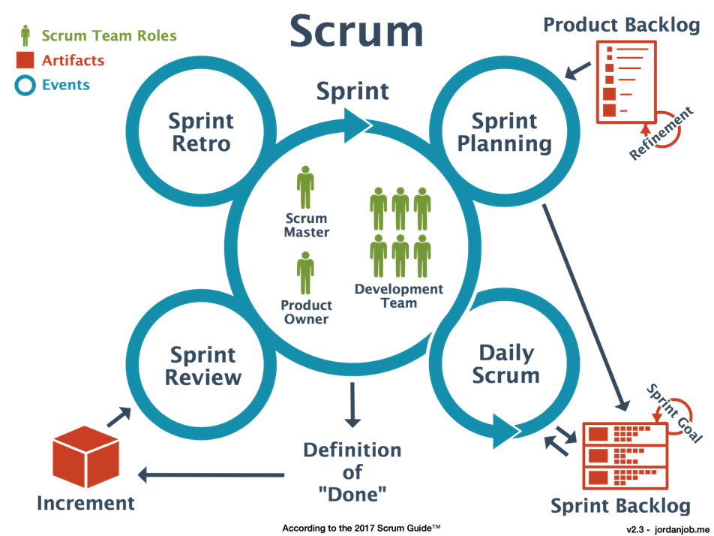

Slide 24
Kanban and Lean
Kanban and Lean are both methodologies that originated from manufacturing practices and have been adapted for use in software development and project management. While they share some similarities, they also have distinct principles and practices. Here's an overview of Kanban and Lean:

Slide 25
Kanban
Kanban is a visual management method that focuses on visualizing work, limiting work in progress (WIP), and optimizing workflow.
The core principles of Kanban include:
Visualizing Workflow: Work items are represented as cards on a Kanban board, with columns representing different stages of the workflow.
Limiting Work in Progress (WIP): Kanban limits the number of work items that can be in progress at any given time to prevent overloading the team and maintain a smooth flow of work.
Managing Flow: Kanban emphasizes optimizing the flow of work through the system by identifying and removing bottlenecks and constraints.
Continuous Improvement: Kanban encourages continuous improvement through feedback loops, measurement, and incremental changes to the process.
Kanban is often used in environments where work is unpredictable or there is a need for flexibility and responsiveness to change.

Slide 26
Lean
Lean is a management philosophy derived from the Toyota Production System (TPS) and focuses on maximizing customer value while minimizing waste.
The core principles of Lean include:
Value: Identifying and delivering value to customers by understanding their needs and eliminating activities that do not contribute to value creation.
Value Stream: Mapping the value stream to identify and eliminate waste, streamline processes, and improve flow.
Flow: Creating a continuous flow of work through the system by reducing batch sizes, minimizing delays, and optimizing throughput.
Pull: Implementing a pull-based system where work is initiated based on customer demand, rather than pushing work through the system.
Perfection: Pursuing continuous improvement and striving for perfection in processes, products, and services.
Lean principles can be applied to various industries and processes, including manufacturing, services, and software development.

Slide 27
Relationship between Kanban and Lean
Kanban is often seen as a tool or technique that supports Lean principles by visualizing workflow, managing flow, and enabling continuous improvement.
Kanban boards can be used as a visual representation of the value stream, helping teams identify waste, optimize flow, and reduce lead times.
While Kanban focuses on managing work in progress and optimizing workflow at the team level, Lean provides a broader framework for organizational transformation and continuous improvement across the entire value stream.

Slide 28
Conclusion
In summary, Kanban and Lean are complementary methodologies that share common principles and practices aimed at improving efficiency, reducing waste, and delivering value to customers.
Kanban provides a practical approach to visualizing and managing work, while Lean offers a broader philosophy for organizational transformation and continuous improvement.

Slide 29
